Slide 1

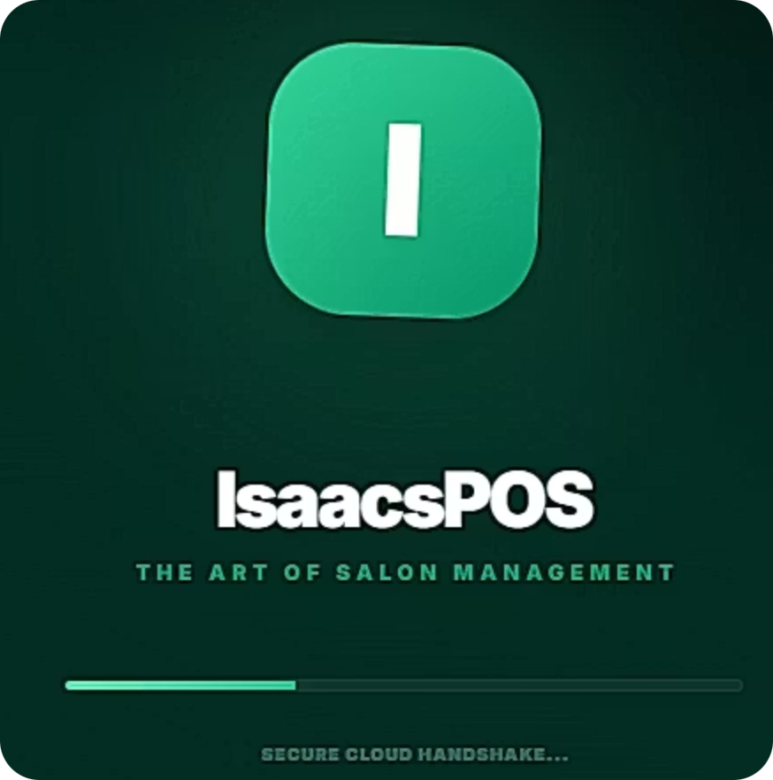
Welcome to Your IsaacsPOS V2.1 Training Program
This comprehensive training will equip you with everything you need to master IsaacsPOS V2.1, the complete salon management system designed for South African businesses.
Purpose
4 Core Modules
What to Expect
Master every feature from admin controls to daily operations
Step-by-step learning paths for Owner, Manager, and Staff roles
Interactive scenarios, real-world examples, and knowledge checks

Slide 2
Training Objectives
By the end of this program, you will be able to confidently navigate and maximize IsaacsPOS V2.1.
1
Master Core System Functionality
2
Optimize Daily Operations
Gain hands-on proficiency with all key features, tailored to your specific role as Owner, Manager, or Staff.
Learn to efficiently manage sales transactions, inventory control, appointment scheduling, and client management.
3
Leverage Business Intelligence
4
Ensure Seamless System Performance
Understand how to access, interpret, and utilize comprehensive reports to drive informed business decisions and growth.
Acquire best practices for routine maintenance, effective troubleshooting, and accessing comprehensive support resources when needed.

Slide 3
Training Objectives
Your Path to Success
Progress Tracking: Each module includes interactive quizzes and scenario-based challenges. Your completion will be tracked, and support is available throughout your journey.
By the end of this program, you'll be confident in using IsaacsPOS V2.1 to streamline salon operations, ensure compliance, and enhance client experiences.
01
02
03
Understand Your Role
Master Daily Operations
Apply Best Practices
Learn permissions and responsibilities specific to Owner, Manager, or Staff
Follow SOPs and handle common scenarios with confidence
Use knowledge checks to reinforce learning immediately

Slide 4

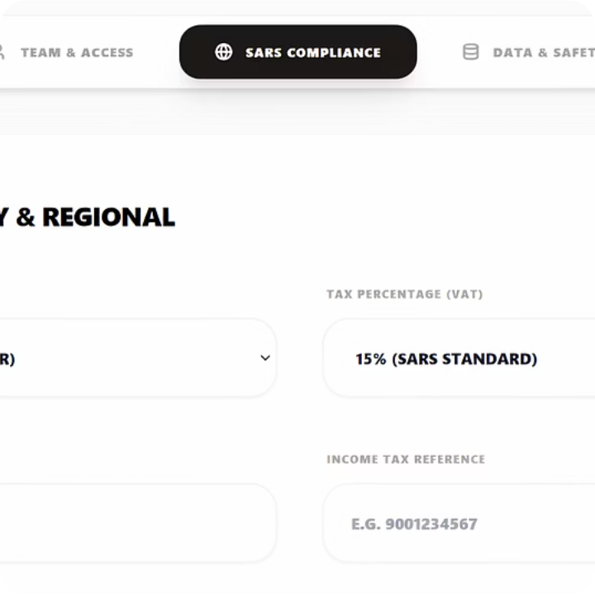
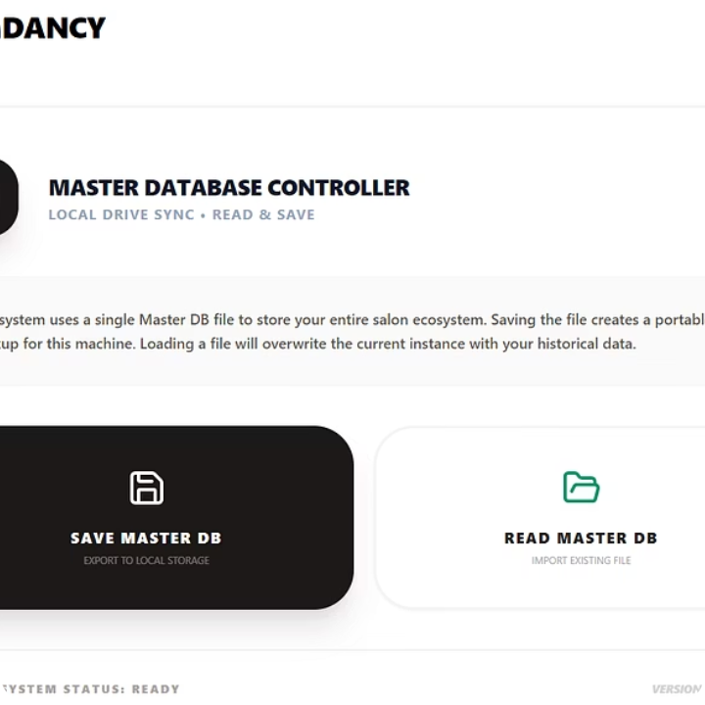
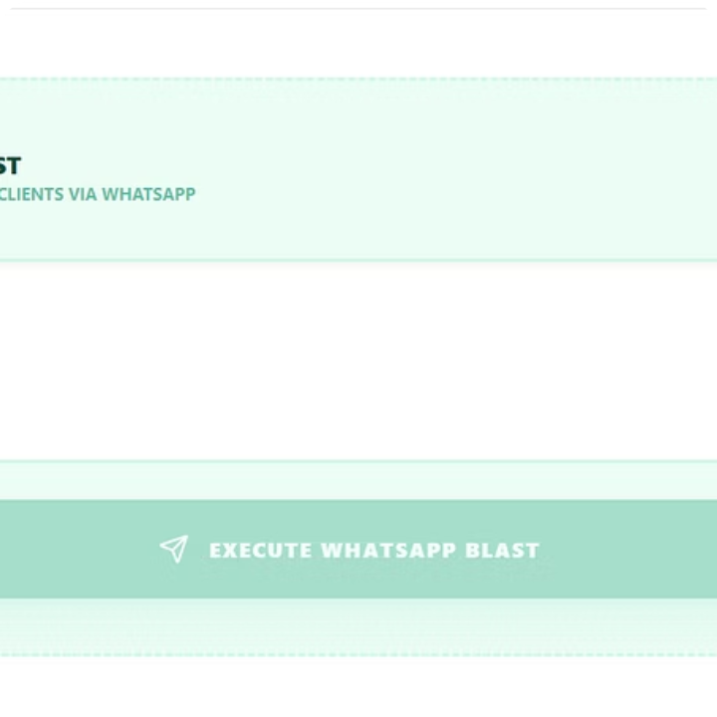

OWNER/ADMIN ONLY
Module 1: Owner/Admin System Manual
As System Architect, you control the structural and legal framework of your salon. This module covers critical functions that only authorized owners should access.
SARS & CIPC Compliance
Master Backups
AI Marketing Hub
Configure VAT rates (default 15%), registration numbers, and salon identity in Admin > SARS Compliance. All details hard-code into Tax Invoice PDFs automatically.
IsaacsPOS is local-first. Daily backups are mandatory. Save .isaacdb files to USB or cloud via Admin > Data & Safety. Restore 100% of data after hardware failure.
Use Gemini 3 AI to generate professional WhatsApp promotions. Build campaigns, generate copy, and broadcast to your database. Limit to once weekly to avoid spam blocks.
Legal Notice: ISAACS AND PARTNERS PTY(LTD) retains sole ownership of source code. Unauthorized system modification is a criminal offense. License tokens are machine-tied with 10-minute handshakes.

Slide 5
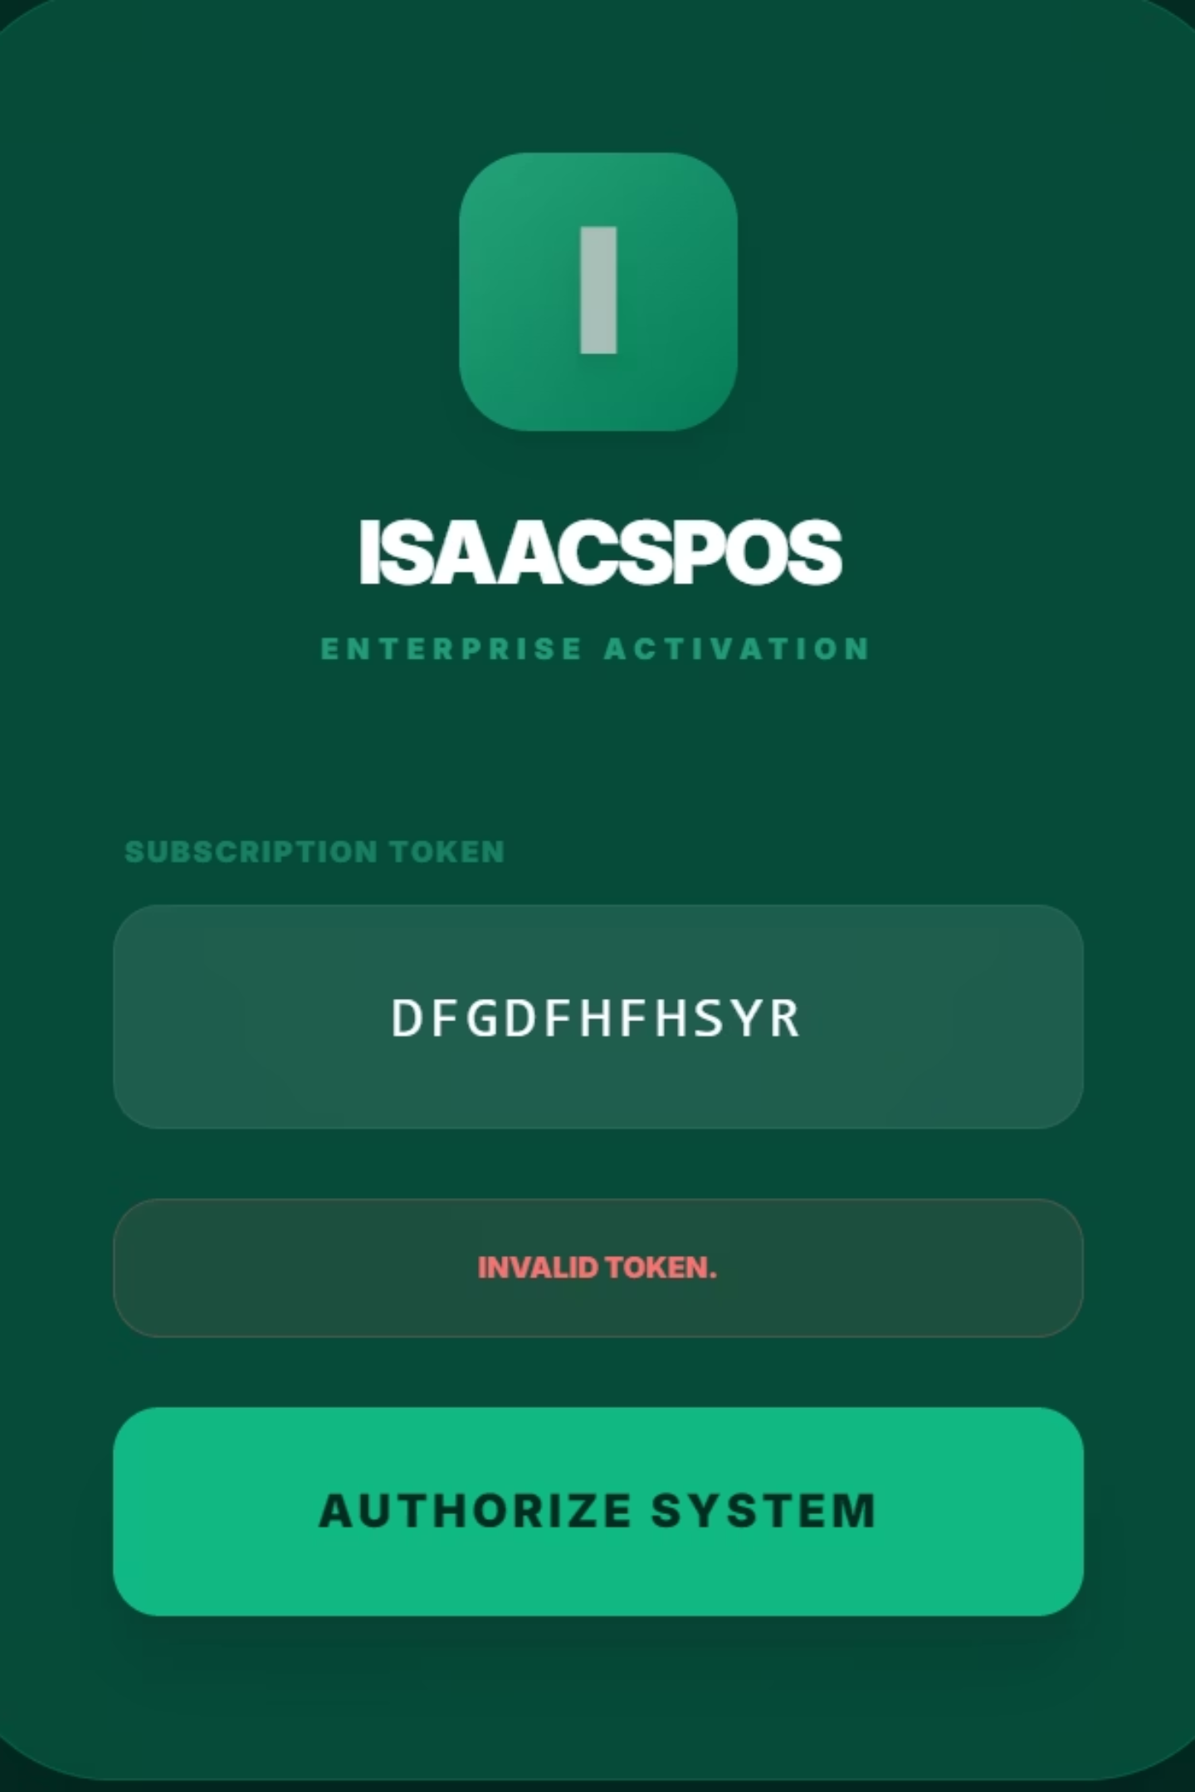
Module 1: Knowledge Check
Test your understanding of Owner/Admin responsibilities with these scenario-based questions.
Scenario 1: Backup Failure
Scenario 2: License Token Error
Your computer crashes and you haven't backed up in 3 weeks. What data can be recovered?
The system displays "Invalid Token." What should you check first?
Answer: Zero. IsaacsPOS is local-first and doesn't store your data remotely. This is why daily backups are mandatory.
Answer: Internet connection. License handshakes occur every 10 minutes and require connectivity.
Key Takeaway: As Owner/Admin, you are responsible for system integrity, legal compliance, and disaster recovery. Never grant unauthorized access to admin functions.

Slide 6


MANAGER AUDIT
Module 2: Manager Audit Manual
Floor Managers are authorized overrides ensuring financial integrity and solving operational blockages. You hold final authority on price overrides and transaction voids.
Financial Controls
Print Z-Report
Daily reconciliation matches your Card Terminal total against POS records. Zero variance indicates perfect accuracy.
Open POS Reconcile
Override Authority
Void Sales: Navigate Sales Journal, as the Manager
Process Refunds: Use "Refund to Wallet" to retain revenue
Manage Team: Override access in Admin > Professionals
Stock Adjustments: Correct inventory discrepancies
Enter Terminal Total
Calculate Variance
The Z-Report is your most critical daily task. Failure creates unaudited tax liabilities.
Critical Security: Never leave the POS unattended while logged in with Manager privileges. Your PIN is your digital signature.

Slide 7

STAFF OPERATIONS
Module 3: Staff Operational Manual
Stylists and Receptionists are the front line of client experience and data entry. This module covers your daily responsibilities and common scenarios.
Opening Procedures
Closing Tasks
Verify internet connection, connect WhatsApp Service, check Service Queue, refresh Agenda
Finalize pending sales, mark completed appointments, hand card slips to Manager
1
2
3
During Shift
Create Folios immediately, save color codes to Registry, offer WhatsApp receipts
Staff Permissions
Stylists: Access Agenda, view Color History, add to Folio, request Package Tokens
Reception: Create Bookings, process Sales, manage Queue, update CRM
Restrictions: Staff cannot void sales, delete products, or access system-wide tax settings
CRM Best Practice
Never guess color formulas. Use the Palette icon to see exact previous mixes. Save NEW records when changing formulas—never overwrite.

Slide 8
Module 4: Complete A-to-Z Feature Dictionary
Your comprehensive reference guide to every IsaacsPOS V2.1 function, from Activation to Zero-Touch Receipts.
Digital Wallet
Folio System
Package Redemption
Virtual bank account storing client change and pre-paid funds, keeping revenue in-house
Real-time shopping cart tracking items, stylists, and taxes before finalization
Secure 6-digit token system for pre-paid services with R0.00 checkout
Loyalty Engine
Offline Mode
Reconciliation
Automatic point calculation (R200 = 1 point) excluding package redemptions
Cached license allows sales and CRM access during internet outages with auto-sync
End-of-day audit comparing POS totals against physical terminal Z-Report
Access the full alphabetical dictionary for detailed explanations of Birthday Automation, Hub Sync, Kiosk Terminal, Manager Override, Service Queue, WhatsApp Automation, and 20+ additional features.

Slide 9




Summary & Key Takeaways
You've completed all four training modules covering Owner/Admin controls, Manager audit procedures, Staff operations, and the complete feature dictionary.
Module 1: Admin
Module 2: Manager
SARS compliance, master backups, AI marketing, license management
Daily Z-Reports, override authority, variance resolution, security protocols
Module 3: Staff
Module 4: Features
Opening/closing SOPs, client experience, CRM management, folio tracking
A-to-Z reference guide for every system function and capability
How Modules Connect
Apply Immediately
Each role builds on the others: Owners set compliance frameworks, Managers ensure daily accuracy, and Staff deliver seamless client experiences. Together, they create a secure, efficient salon operation.
Don't wait to implement your learning. Start with your role-specific checklist today and refer to the A-to-Z guide whenever questions arise.

Slide 10
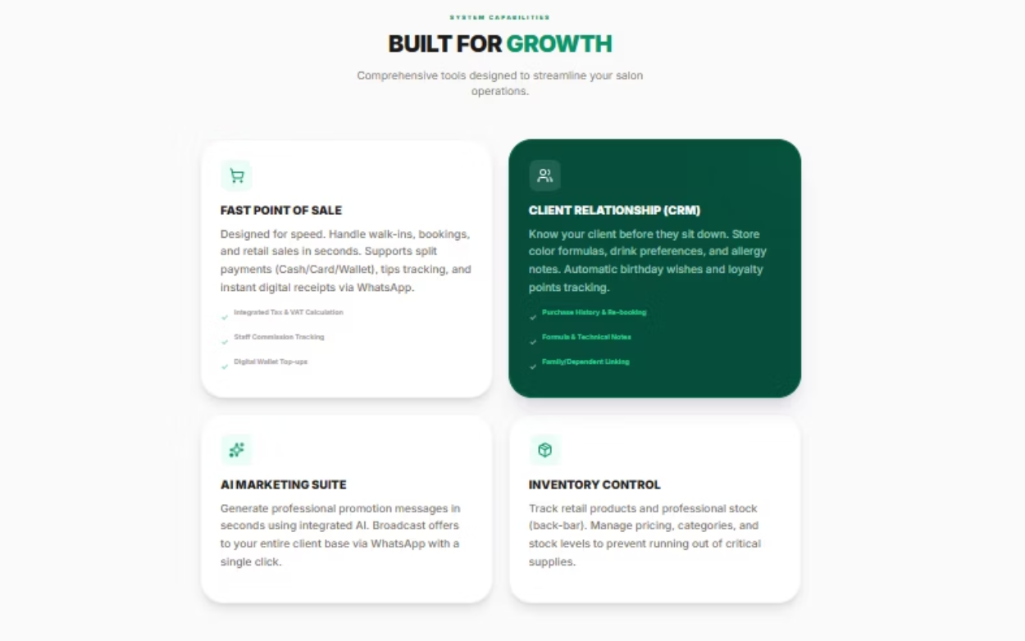

Next Steps & Support Resources
Accessing Additional Materials
Your training doesn't end here. Access video tutorials, downloadable quick-reference guides, and updated documentation through the IsaacsPOS support portal.
Follow-Up Training
Advanced workshops: Monthly sessions on new features and optimization
One-on-one coaching: Schedule personalized support for complex scenarios
Certification program: Become an IsaacsPOS expert with our advanced certification track
Get Help When You Need It
Email Support: support@isaacsandpartners.online
Phone: Available 9 AM - 5 PM CAT weekdays
WhatsApp Support: +27718831097
We Value Your Feedback: Share your training experience and suggestions for improvement. Your input helps us refine the program for future users.

Slide 11

Thank You & Your Training Journey Ahead
Congratulations on completing the IsaacsPOS V2.1 training program! You now have the knowledge and skills to maximize this powerful salon management system.
Your Growth Matters
Take Action Now
Stay Connected
Every skill you've learned contributes to your salon's success and your professional development
Commit to applying at least one new practice from each module this week
Join our user community, share feedback, and continue learning with fellow salon professionals
"Success in mastering IsaacsPOS isn't about perfection—it's about progress. Start where you are, use what you know, and grow every day."
Your commitment to excellence sets you apart. Thank you for investing in your training. We're here to support your ongoing success.

